Slide 1


NSDC
Introduction
Dataset and Cleaning
Model
Evaluation
Conclusion
Page 01
Outfit
Generator
Presented by:
Keyan Saguibo, Hana Tanisaka, Aarnav Dharia, and Itzel Valdez

Slide 2
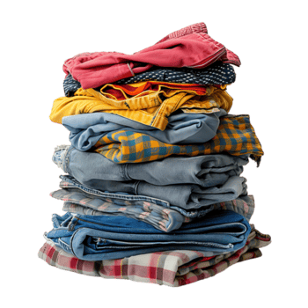
NSDC
Introduction
Dataset and Cleaning
Model
Evaluation
Conclusion
Page 02
Introduction
Our Goal: develop an outfit recommendation system that generates cohesive outfits from individual clothing items using machine learning techniques and outfit compatibility patterns.
Our project also incorporates clothing item IDs as an accessibility feature for colorblind users, helping generate outfit recommendations without relying solely on color perception.

Slide 3
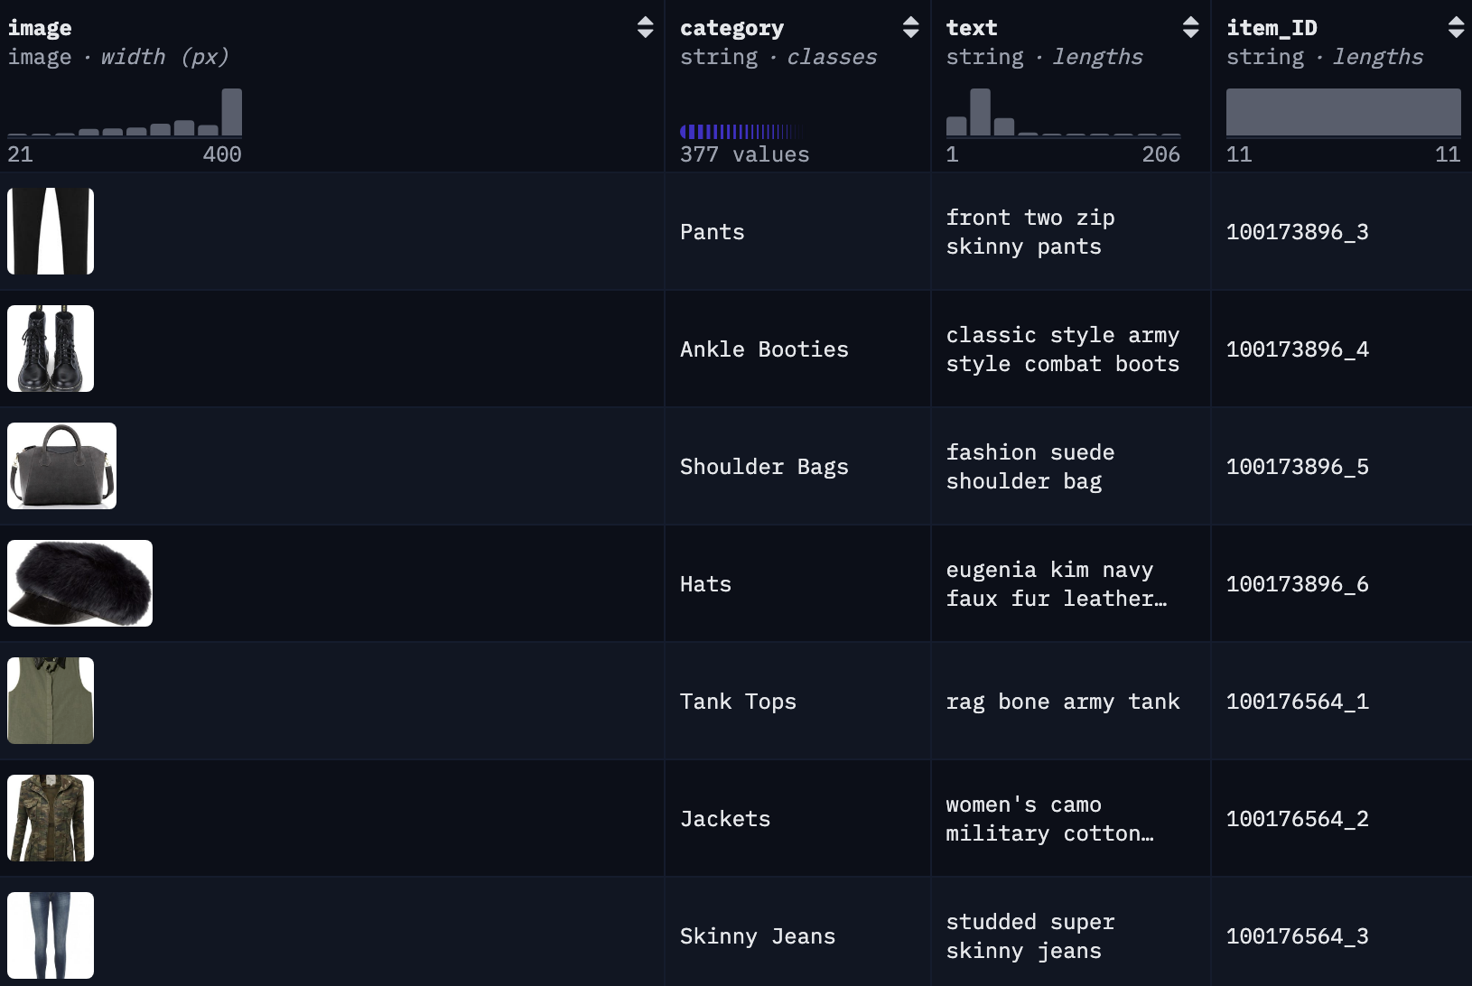
NSDC
Introduction
Dataset and Cleaning
Model
Evaluation
Conclusion
Page 03
Dataset Overview
Polyvore Dataset Overview:
94.1k rows of clothing items grouped into complete outfits. Each row includes information such as:
an image of the item
clothing category (top, bottom, shoes, etc.),
short text description,
outfit IDs indicating which items belong together

Slide 4
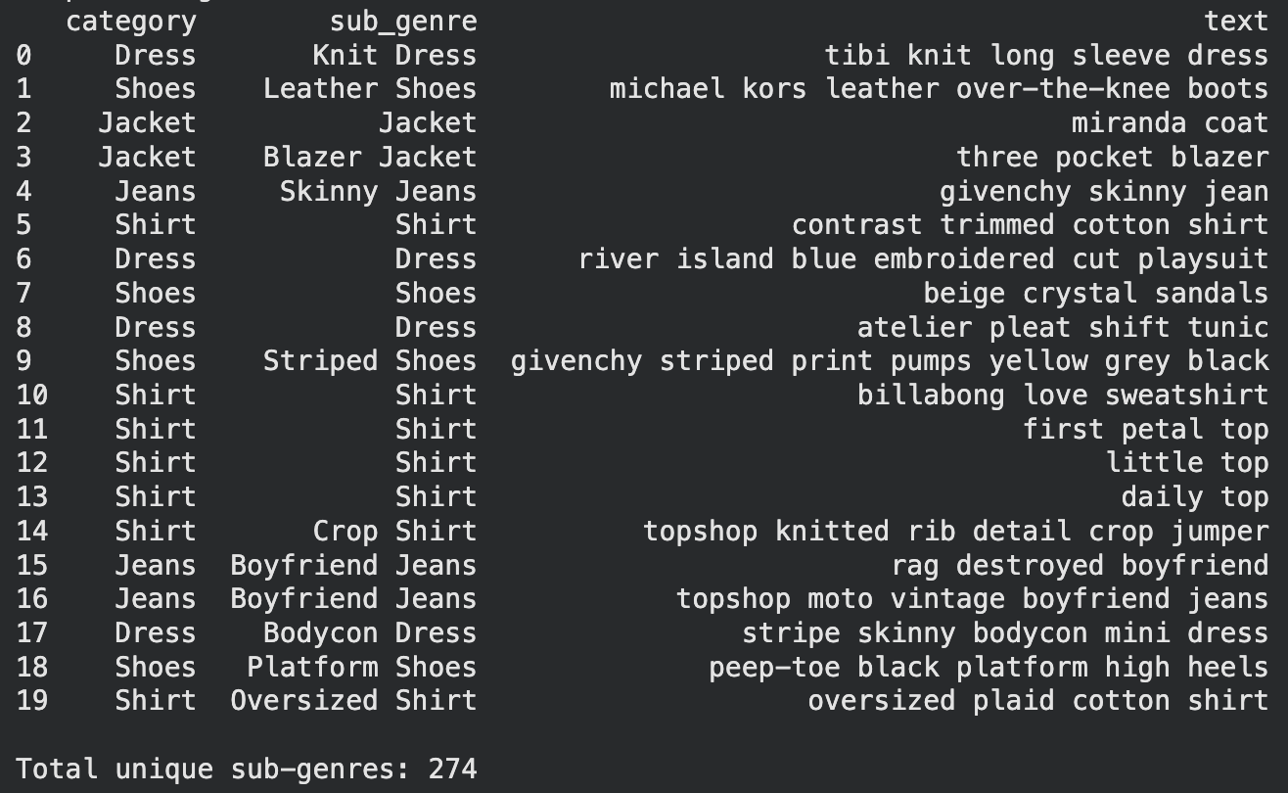
NSDC
Introduction
Dataset and Cleaning
Model
Evaluation
Conclusion
Page 04
Cleaning
Our Cleaning Process:
We began with removing irrelevant or non-fashion categories such as makeup, accessories, and even curtain rods. We ended up removing around 261 categories
Secondly, we consolidated categories into broader labels such as Shoes, Jeans, Dress:
Ex. 'Boyfriend Jeans' → ‘Jeans',
'Knee Length Skirts’ → ‘Skirts, ‘Jumpsuit’ → ‘Dress’
Lastly, we created a subcategory column using the item descriptions and original category labels. This helped keep more detail, such as “Wide Leg Jeans” or “Ankle Boots,” while still grouping items under broader categories like “Jeans” or “Shoes.” This allowed the model to learn more specific clothing combinations without making the data too messy.

Slide 5
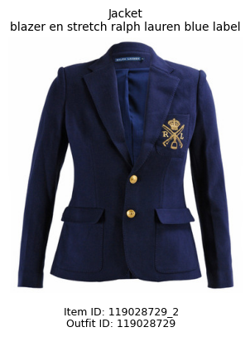
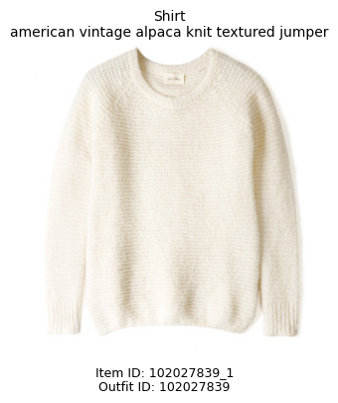
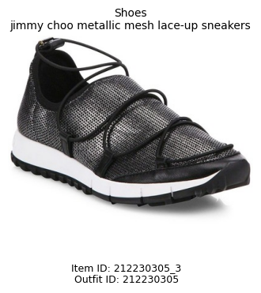
NSDC
Introduction
Dataset and Cleaning
Model
Evaluation
Demo
Page 05
Our Modeling Process
We decided to build two models so we could first create a strong foundation and then improve on it.
Model 1 is a category-based co-occurrence recommender that learns which clothing categories commonly appear together in outfits. This gives the model a simple baseline for understanding outfit patterns.
Model 2 builds on that idea by using more detailed information, such as category and subcategory, to make recommendations that are not only structurally correct, but also more visually and stylistically compatible.
Model 1:
Model 2:
Model 1 Outfit generated for input: ‘Jeans’

Slide 6


NSDC
Introduction
Dataset and Cleaning
Model
Evaluation
Demo
Page 06
What is Co-Occurrence?
Recommendation technique that learns relationships between items based on how frequently they appear together. Based of the data, it then generates a count of the occurrences. These models learns which clothing categories and subgenres commonly appear together in outfits respectively.
Co-Occurrence
Model 1
Learned relationships using general clothing categories
categories were broad -> repetitive recommendations
Model 2
Learns relationships using detailed fashion sub-genres
Narrow categories -> detailed pairings
Why Co - Occurrance?
Learns outfit compatibility directly from data
Based off real fashion pairing patterns

Slide 7

NSDC
Introduction
Dataset and Cleaning
Model
Evaluation
Demo
Page 07
Recommendation Function
Model 1 (Item Recommendation)
The model identifies items that are often paired with the input and ranks them by the number of occurrences found in the dataset.
The items of each category (Shirt, Shoes, Jacket) with the highest counts is returned and will be included in the final recommended outfit.
Model 2 (Sub-Genre Recommendation)
Uses a co-occurrence map - a table that tracks how often two items appear in the same outfit - to find and rank sub-genres that pair well with the input
Sub-genres from the same category as the input are blocked from results
ex) if the outfit already has a dress, shirts and pants won't be recommended

Slide 8


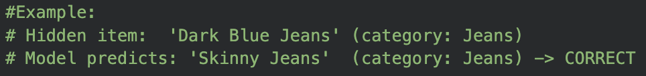
NSDC
Introduction
Dataset and Cleaning
Model
Evaluation
Demo
Page 08
Evaluation
Top-5 Category Accuracy:
We tested how well the model could predict a missing clothing category from an outfit
Result:
Our Model 2 achieved a Top-5 Category Accuracy of 87.20%, meaning that when one item category was hidden from a test outfit, the correct missing category appeared in the model’s top five recommendations 87.20% of the time. This suggests the model learned strong relationships between clothing categories and can usually identify what type of item belongs in an outfit.

Slide 9
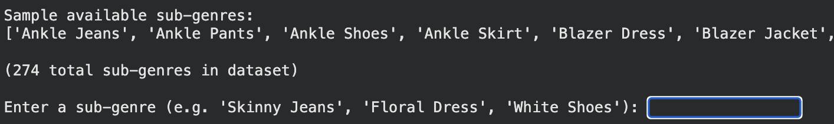
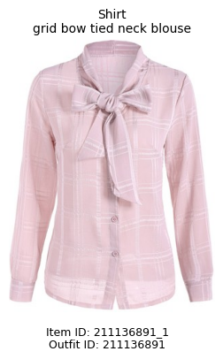
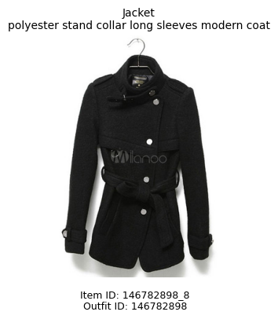
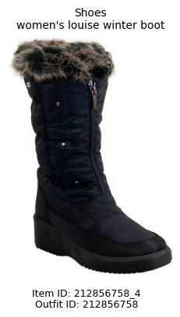
NSDC
Introduction
Dataset and Cleaning
Model
Evaluation
Demo
Page 09
Demo
Input: Skinny Jeans

Slide 10
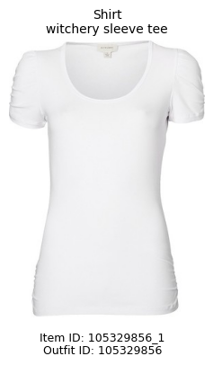
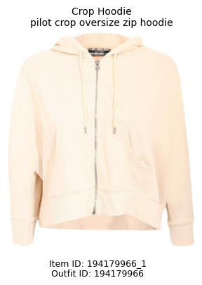
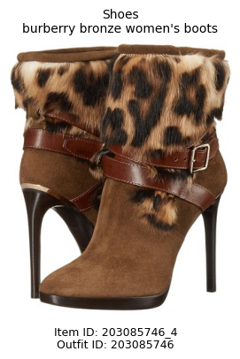
NSDC
Introduction
Dataset and Cleaning
Model
Evaluation
Demo
Page 10
Demo
Input: Wide Leg Jeans

Slide 11
NSDC
Introduction
Dataset and Cleaning
Model
Evaluation
Demo
Page 11
Thank You!
Any Questions?

